Slide 1

Easy code
Final project of Blog web application development
ZHU ZHEHAO
1709853G-I011-0069
Supervisor: LIANG ZHIYAO

Slide 2

Motivation
Design theory
Technology
Difficulties
Demo
Future work
Q & A
A web app full-stack design

Slide 3




Motivation

Slide 4
User uml
Visitor uml
Design theory

Slide 5
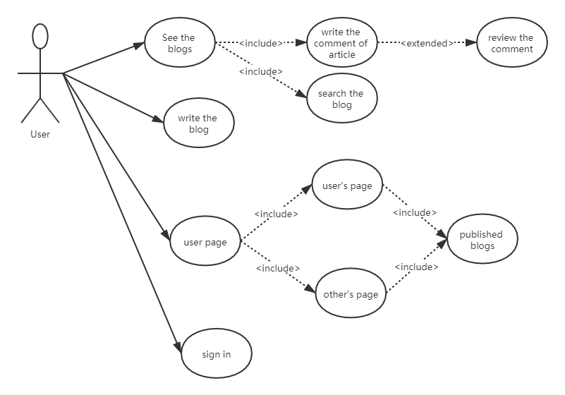
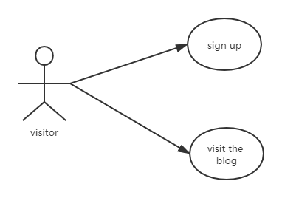
UML

Slide 6
Technology
Front-End
Back-End
Front-Back-Connection
Database
Windows 10

Slide 7
Front-End
Vue.js
Router setting
Markdown
Login state

Slide 8
Router setting
Vue router
Vue.js official router controller
Nested route/view mapping
Modular, component-based router configuration

Slide 9
Blue is normal page
Green is component
Yellow is dynamic page
Router setting
/login
Sign in
/blank
Terminal blank
/login
Login
/
home
/account
Account center
/login/Signup
Sign up
/blog
Blog query
/blogcenter/:username
Each user’s articles
/signupemail
Signup email verify
/blog/newArticle
New article
/blog/article/:id
Each article

Slide 10
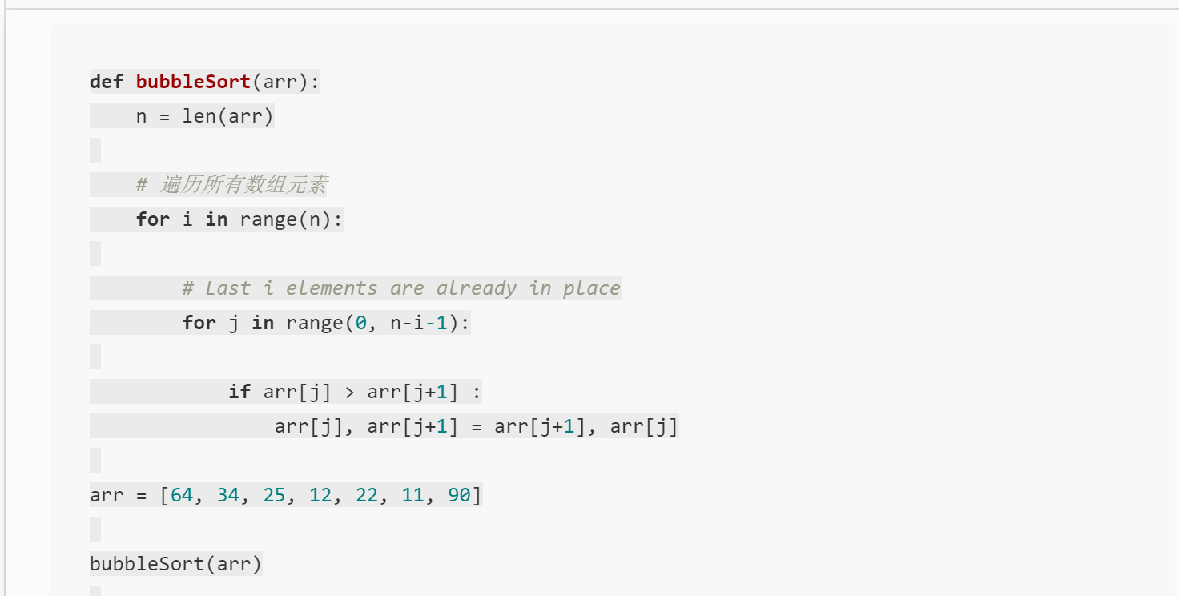
Markdown
Code highlight

Slide 11
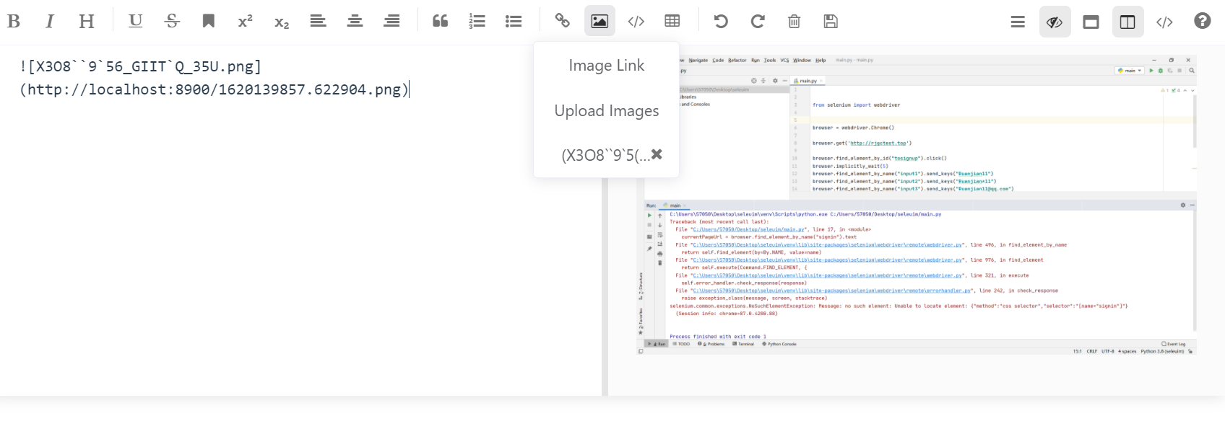
Markdown
Picture upload

Slide 12
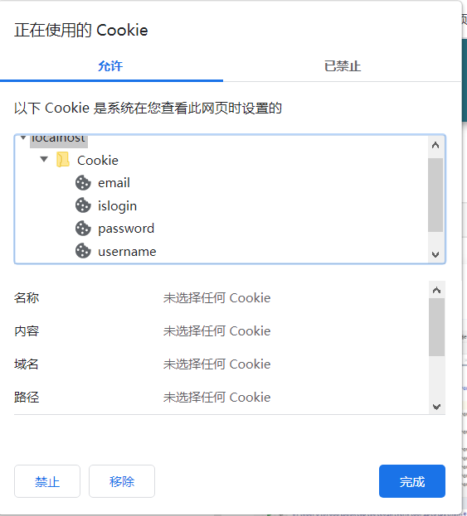
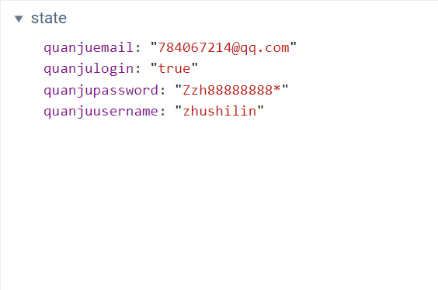
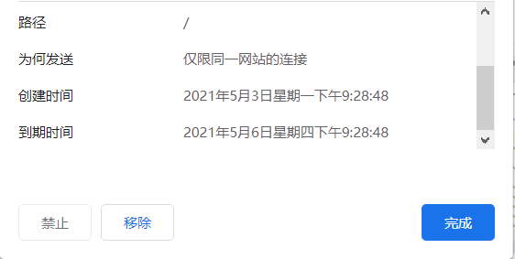
Login state
Vuex
Vue-cookie

Slide 13
Back-End
Python
Flask
Function part

Slide 14

Flask is a lightweight web application framework written in Python
Customizable
Microframework

Slide 15
Function part
Blog query
Show in blog page
Blog.py
User operation
Sign in
Sign up
Change password
Blog operation
Add
Delete
User.py
Email verification
Blog details
Content
Comment
review

Slide 16

Front-Back-Connection
axios
Json
Formdata
Front-End
Back-End

Slide 17
Database
Sqlite3
bloginfo
id | Integer
title | Text
author | Text
introduction | Text
content | Text
email | Text
type | Text
Date | Text
blogcommentinfo
id | Integer
blog_id | Integer
author | Text
content | Text
reviewcommentinfo
Id | Integer
comment_id | Integer
author | Text
content | Text
emailverify
id | Integer
email | Text
verifycode | Text
addtime | Text
Userinfo
id | Integer
email | Text
username | Text
password | Text

Slide 18
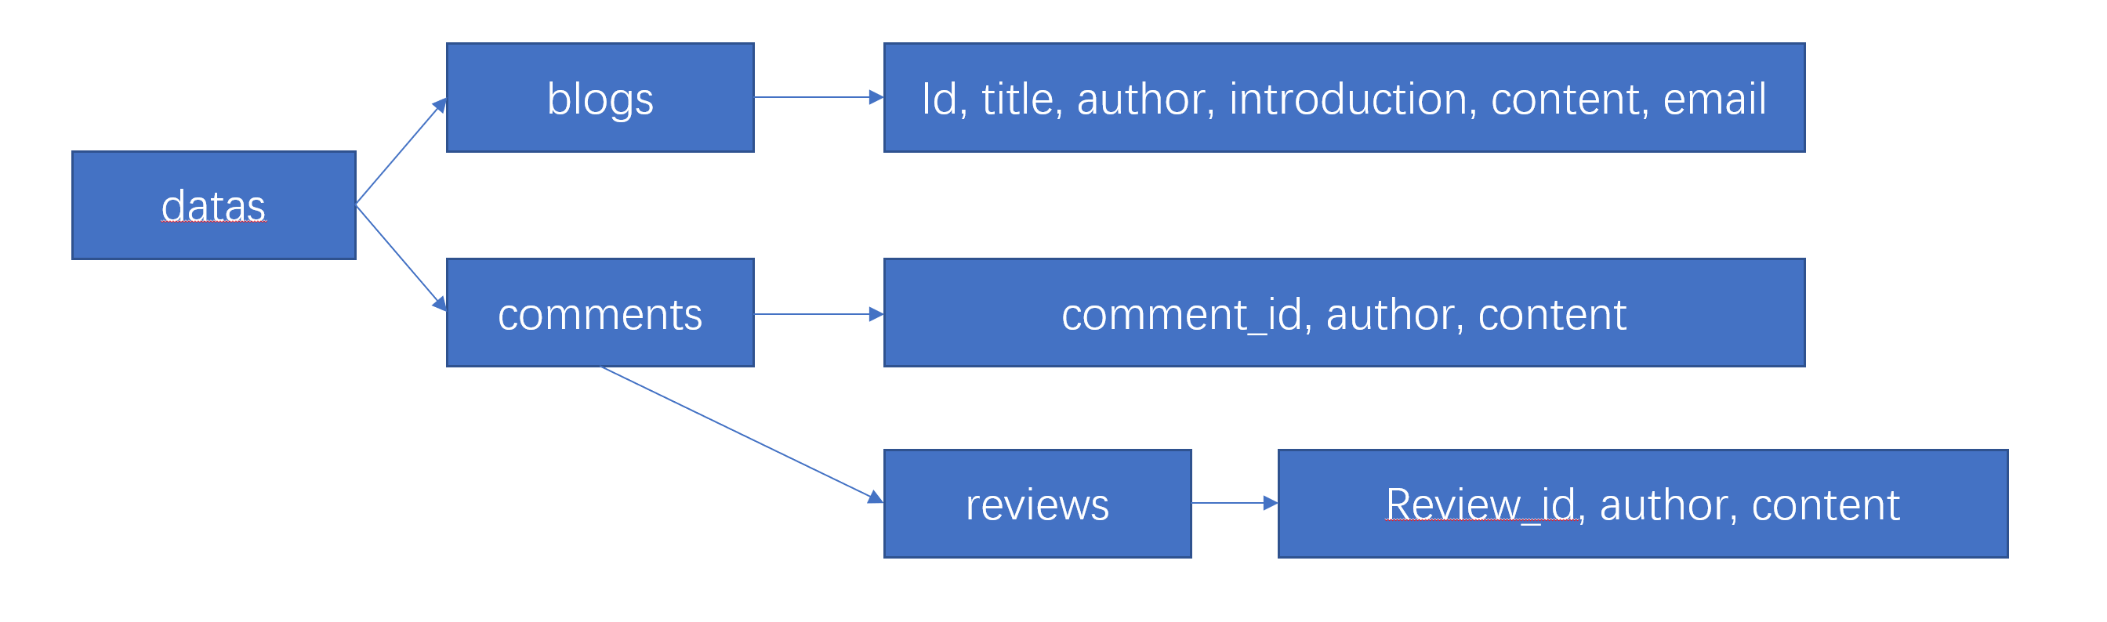
Difficulties
Return the blog detail to front-end

Slide 19
Difficulties
Upload the pictures in the Markdown
Front-end visit the picture
Front-end upload a formdata
picture
Give the picture with the website
Local save folder
Open a http.server for user visit the picture
website
Back-end get formdata save it and use the name and the time return a website
Save picture

Slide 20
Front-end
Install the vue2 and vue-cli
Open the front-end folder terminal input npm install
In the terminal input npm run serve
Demo
Back-end
Install the python3.7 or create a virtual environment
Open the back-end folder terminal input pip install –r requirements.txt
In the terminal input set flask_app=app.py
In the terminal input set flask_env=development
In the terminal input flask run
Open the images folder terminal input python –m http.server 8900
Windows 10

Slide 21
Future work
Add a management system to control the blogs content avoiding the numbers of similar or wrong blogs.
Add an email remind users someone comment or review
Change the auto login way. Cookie is a not safe way to save the username and password. If use the token or session and use hash to encrypt it, it will not be intercepted from others. It will be more safe
Add the base auto translate function for system for Chinese users and foreign users.

Slide 22
Q & A

Slide 23
Thanks

